Slide 1

Assembler Tutorial
This program is part of the software suite
that accompanies
The Elements of Computing Systems
by Noam Nisan and Shimon Schocken
MIT Press
www.nand2tetris.org
This software was developed by students at the
Efi Arazi School of Computer Science at IDC
Chief Software Architect: Yaron Ukrainitz

Slide 2
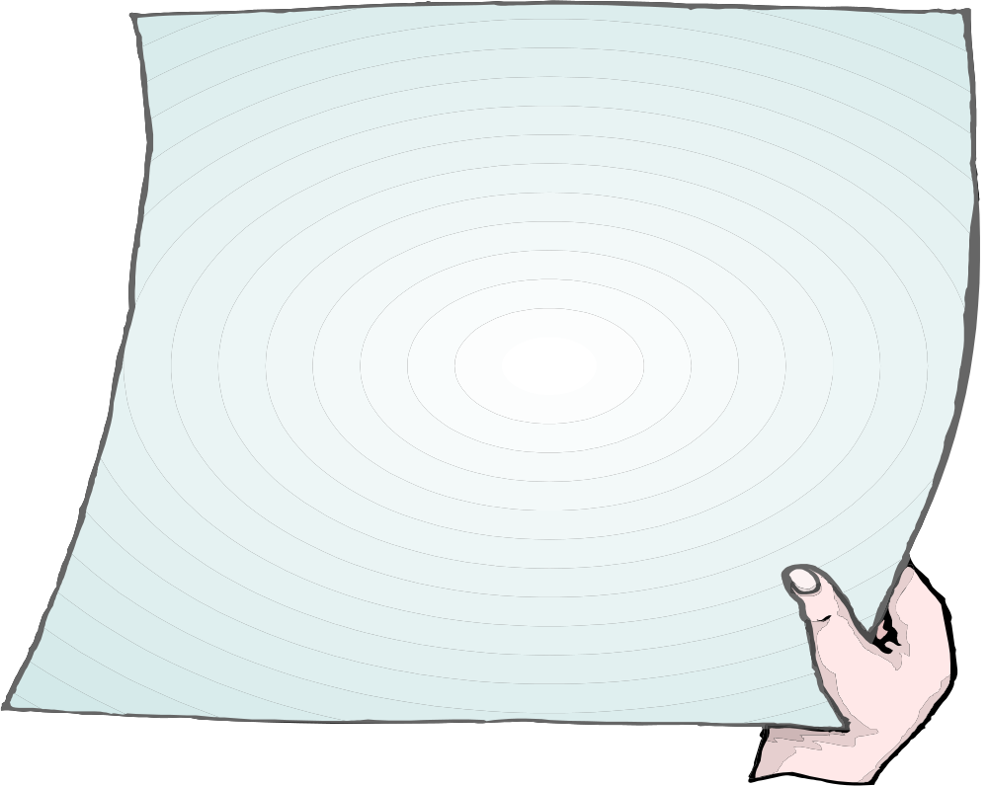
Background
The Elements of Computing Systems evolves around the construction of a complete computer system, done in the framework of a 1- or 2-semester course.
In the first part of the book/course, we build the hardware platform of a simple yet powerful computer, called Hack. In the second part, we build the computer’s software hierarchy, consisting of an assembler, a virtual machine, a simple Java-like language called Jack, a compiler for it, and a mini operating system, written in Jack.
The book/course is completely self-contained, requiring only programming as a pre-requisite.
The book’s web site includes some 200 test programs, test scripts, and all the software
tools necessary for doing all the projects.

Slide 3

The book’s software suite
(All the supplied tools are dual-platform: Xxx.bat starts
Xxx in Windows, and Xxx.sh starts it in Unix)
Simulators
(HardwareSimulator, CPUEmulator, VMEmulator):
Used to build hardware platforms and
execute programs;
Supplied by us.
This tutorial is about the
assembler
Translators (Assembler, JackCompiler):
Used to translate from high-level to low-level;
Developed by the students, using the book’s specs; Executable solutions supplied by us.
The machine code generated by the assembler can be tested either in the hardware simulator or in the CPU emulator.
Other
Bin: simulators and translators software;
builtIn: executable versions of all the logic gates and chips mentioned in the book;
OS: executable version of the Jack OS;
TextComparer: a text comparison utility.

Slide 4
Assembler Tutorial
I. Assembly program example
II. Command-level Assembler
III. Interactive Assembler
Relevant reading: Chapter 4: Machine and Assembly Language

Slide 5

Assembler Tutorial
Part I:
Assembly Programming
at a Glance

Slide 6
Example
Sum.asm
Sum.hack
// Computes sum=1+...+100.
@i // i=1
M=1
@sum // sum=0
M=0
(LOOP)
@i // if (i-100)=0 goto END
D=M
@100
D=D-A
@END
D;JGT
@i // sum+=i
D=M
@sum
M=D+M
@i // i++
M=M+1
@LOOP // goto LOOP
0;JMP
(END) // infinite loop
@END
0;JMP
0000000000010000
1110111111001000
0000000000010001
1110101010001000
0000000000010000
1111110000010000
0000000001100100
1110010011010000
0000000000010010
1110001100000001
0000000000010000
1111110000010000
0000000000010001
1111000010001000
0000000000010000
1111110111001000
0000000000000100
1110101010000111
Assembler

Slide 7
Example
Sum.asm
// Computes sum=1+...+100.
@i // i=1
M=1
@sum // sum=0
M=0
(LOOP)
@i // if (i-100)=0 goto END
D=M
@100
D=D-A
@END
D;JGT
@i // sum+=i
D=M
@sum
M=D+M
@i // i++
M=M+1
@LOOP // goto LOOP
0;JMP
(END) // infinite loop
@END
0;JMP
The assembly program:
Stored in a text file named Prog.asm
Written and edited in a text editor
The assembly process:
Translates Prog.asm into Prog.hack
Eliminates comments and white space
Allocates variables (e.g. i and sum) to memory
Translates each assembly command into a single 16-bit instruction written in the Hack machine language
Treats label declarations like (LOOP) and (END) as pseudo commands that generate no code.

Slide 8
Assembler Tutorial
Part II:
Learn how to invoke the supplied assembler from
the OS shell level.
(the assembler that you have to write in project 6 should have the same GUI and behavior)

Slide 9
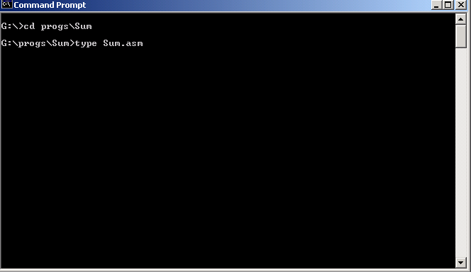
The command-level assembler
Display the assembly source code (contents of the .asm text file)
We illustrate how to use the assembler in the Windows command level (DOS); The Unix way is similar.

Slide 10
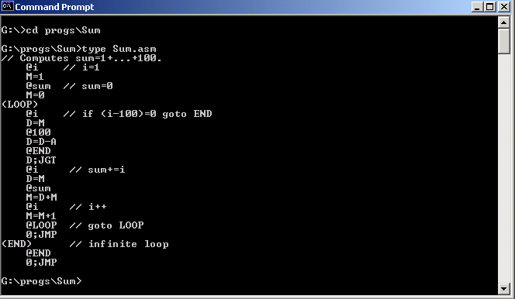
Inspecting the source file
Source code is shown

Slide 11

Invoking the Assembler
Invoke the assembler program
Name of the file to be translated (argument of the assembler program).

Slide 12
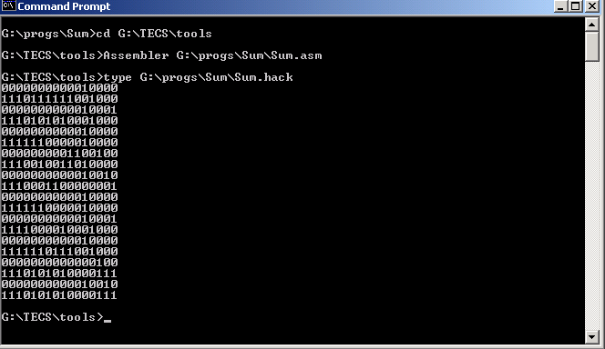
Invoking the Assembler
Display the generated machine code
Two ways to test the generated machine code:
1. Invoke the hardware simulator, load the Computer.hdl chip, then load the code (.hack file) into the internal ROM chip;
2. Load and run the code in the CPU emulator (much quicker).

Slide 13
Hardware Simulation Tutorial
Part III:
Learn how to use the interactive Assembler

Slide 14
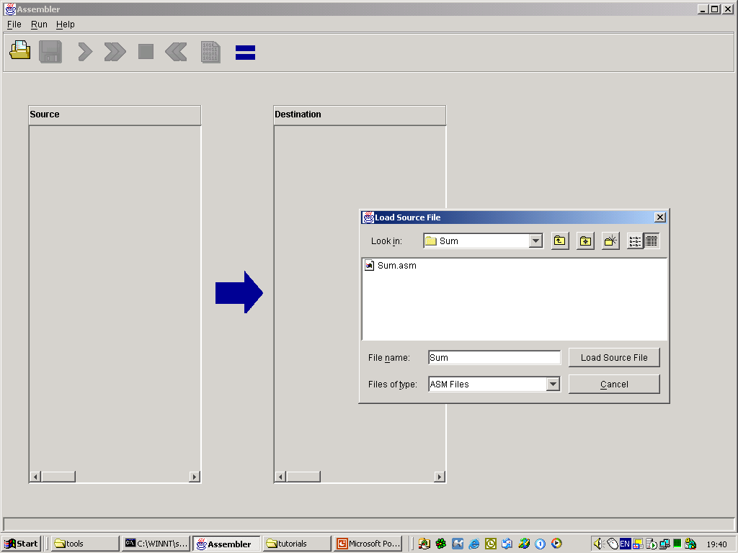
Loading an assembly program
Navigate to a directory and select an .asm file.

Slide 15
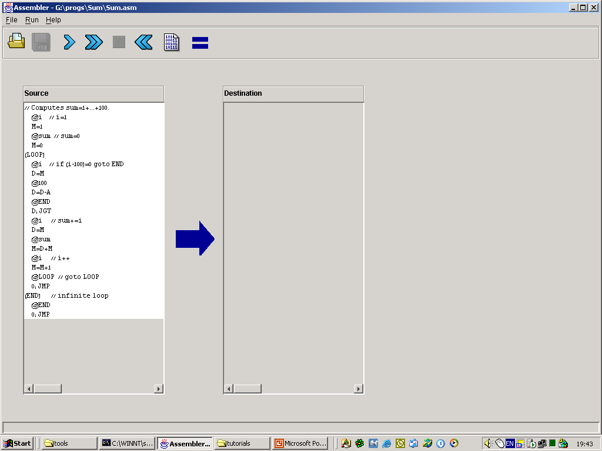
Loading an assembly program
Read-only view of the assembly source code
To edit it, use an external text editor.

Slide 16
Translating a program
Immediate translation
(no animation)
Start from the beginning
Pause the translation
Translate the entire program
Translate line-by-line

Slide 17
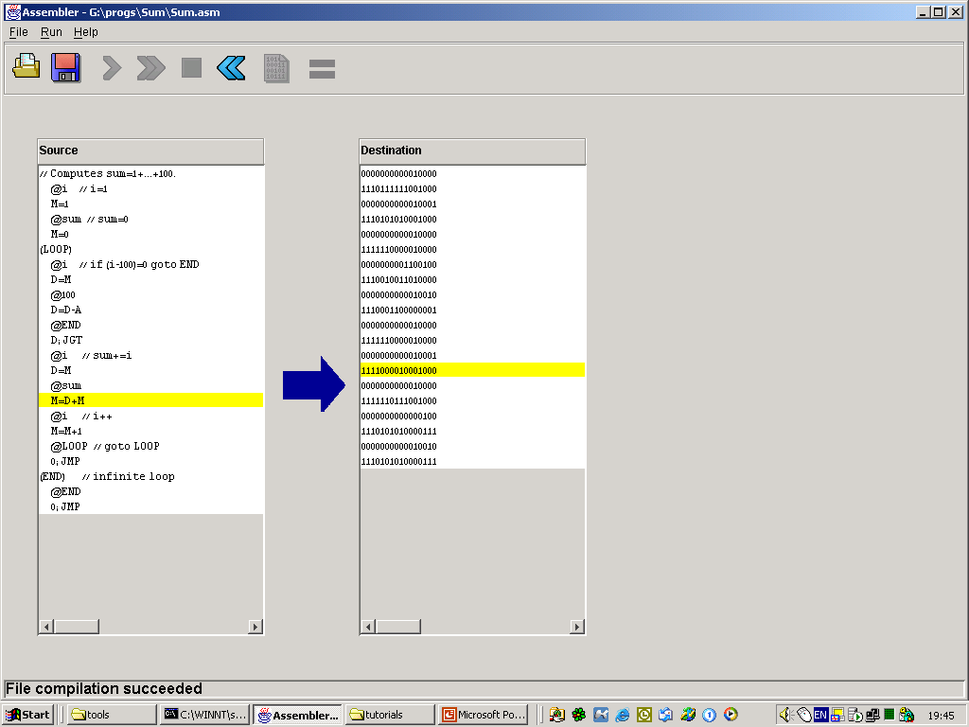
Inspecting the translation
2. The corresponding translated code is highlighted
1. Click an assembly command

Slide 18
Saving the translated code
Saves the translated code in a .hack file
The “save” operation is enabled only if the translation was error-free;
Otherwise, the translation stops with an error message.

Slide 19
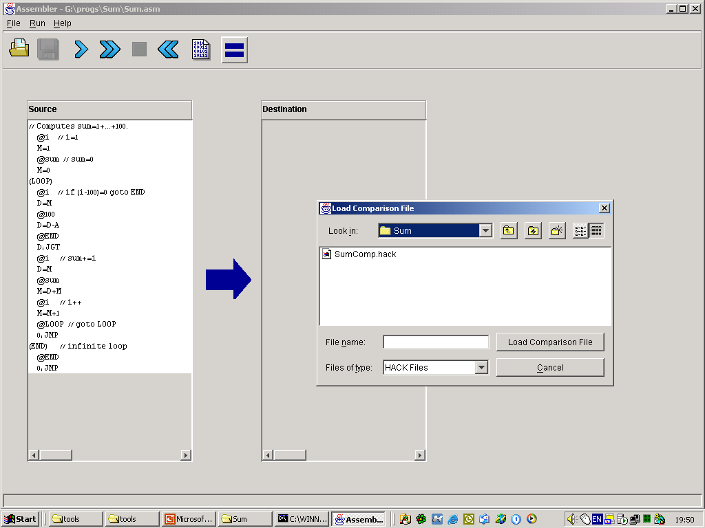
Using Compare Files
1. Load a compare file
2. Select a compare (.hack) file

Slide 20
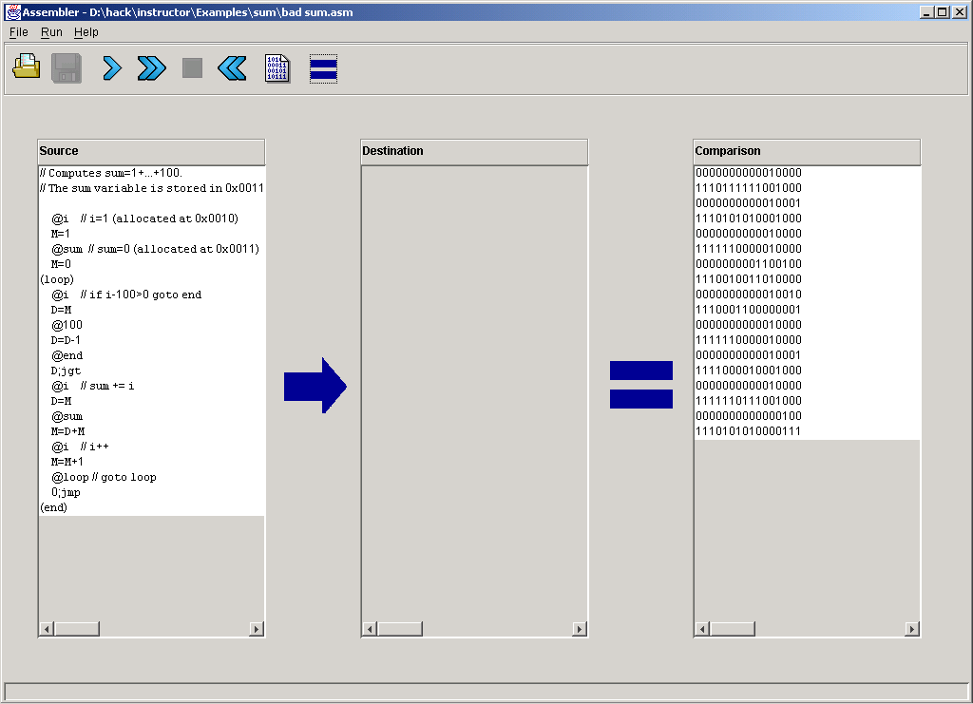
Using Compare Files
2. Translate the program (any translation mode can be used)
1. Compare file is shown

Slide 21
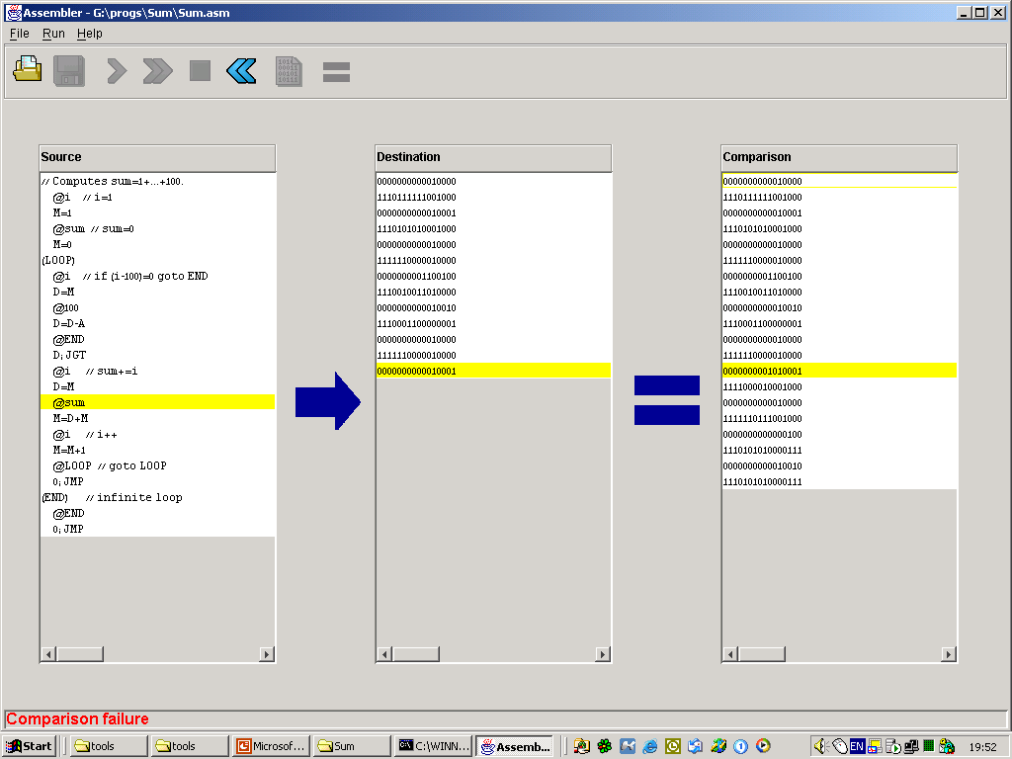
Using Compare Files
The translation of the highlighted line does not match the corresponding line in the compare file.

Slide 22
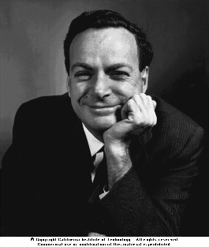

End-note: R. Feynman on why symbols don’t matter compared to their meaning
On weekends, my father would take me for walks in the woods and he’d tell me about interesting things that were going on. “See that bird?” he says. “It’s a Spencer Warbler.” (I knew he didn’t know the real name.) “Well, in Italian, it’s Chutto Lapittida. In Portuguese, it’s a Bom da Peida. In Chinese, it’s a Chung-long-tah, and in Japanese, it’s Katano Tekeda. You can know the name of that bird in all the languages of the world, but when you’re finished, you’ll know absolutely nothing whatever about the bird. You’ll only know something about people in different places, and what they call the bird. So let’s look at the bird and see what it is doing – that’s what counts.” This is how I learned very early the difference between knowing the name of something and knowing something.
Richard P. Feynman, The Making of a Scientist, 1988.

